Slide 1



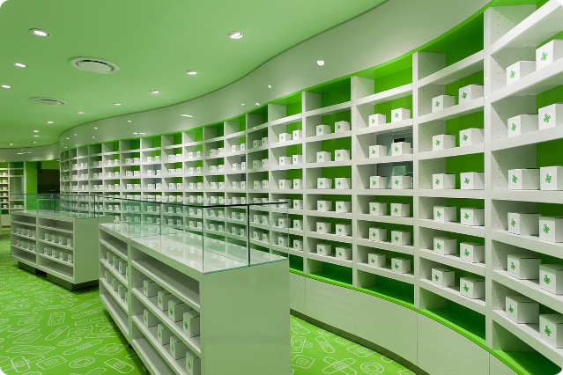
ss
Pharmacy Store
→ This presentation covers the technical components of a pharmacy store management system, including Java features, data structures, and database management systems.

Slide 2
Prepared By:-
Student 1 Name : ZINZUVADIYA KRISH KAMLESHBHAI(23002170210138)
Batch: D6 Branch: IT
Student 2 Name : PANCHAL SMIT PARESHBHAI(23002170210069)
Batch: D6 Branch: IT
Student 3 Name : RUPAPARA MANTHAN HARESHBHAI(23002170110161)
Batch: D6 Branch: CE
Student 4 Name : PANARA KUNJ VIJAY (23002170110102)
Batch: D6 Branch: CE
Student 5 Name : SHETH RISHI PRATIKBHAI (23002170110177)
Batch: D6 Branch: CE

Slide 3

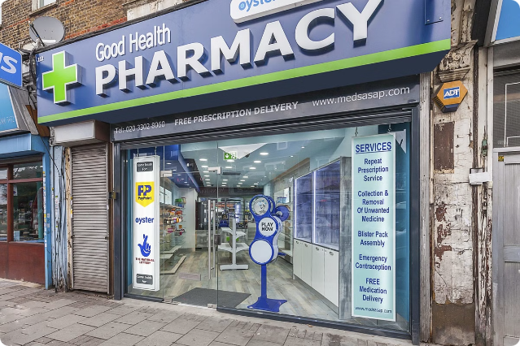
Introduction
Our pharmacy has been serving the community for years. We're dedicated to providing high-quality medications and exceptional customer service.
In Our code we have using the concept of java, data structures, and use of dbms.
insertion of medicine, update medicine and also delete medicine and all other and authentication of admin priority.

Slide 4
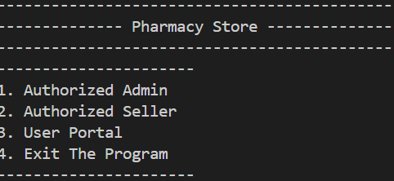
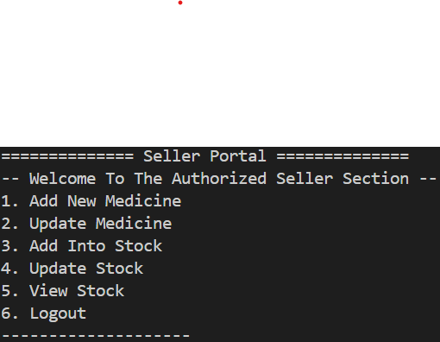
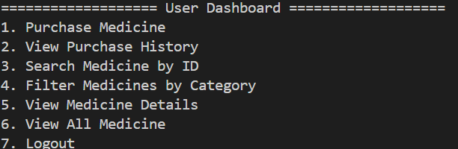
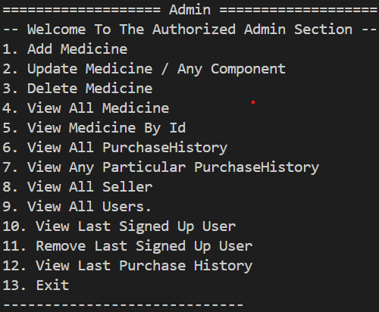
Flowchart
START
Loop
Loop
True
If 1
False
If 2
False
Admin
True
False
False
If
6
If
7
False
True
If
13
False
True
END

Slide 5
ER Diagram
name
sname
id
description
sid
price
sell
M
1
seller
susername
medicines
expiration_date
1
semail
spassword
manufacturer
category
sphone_number
stock_quantity
user_name
buy
u_age
u_name
u_ gender
pid
medicine_id
u_id
purchase_history
user
M
M
sign
up
N
purchase_date
quantity
u_ email
total_payment
u_ phone_number

Slide 6
File Handling in Java
File Class
FileWriter Class
Use Cases
Basic operations: create, delete, and rename files.
Writing data with append mode and character encoding in creating a bill for customer.
Save transaction receipts in txt file format, product inventories, and system logs. Generate and store reports.

Slide 7

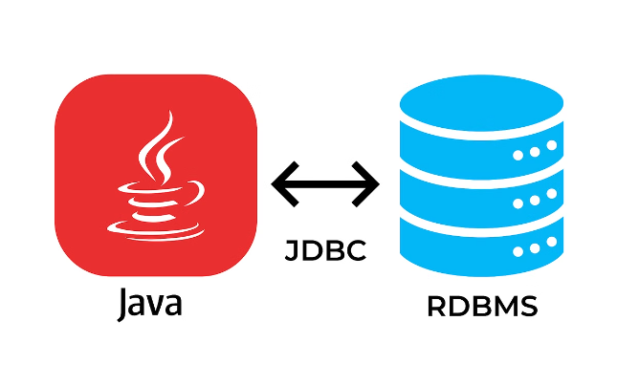
JDBC (Java Database Connectivity)
Overview
Facilitates interaction between Java applications and relational databases.
Key Components
DriverManager, Connection, Statement, PreparedStatment, CallableStatement
and ResultSet.
Use Cases
Query stock levels, manage prescriptions, and update inventory records.

Slide 8

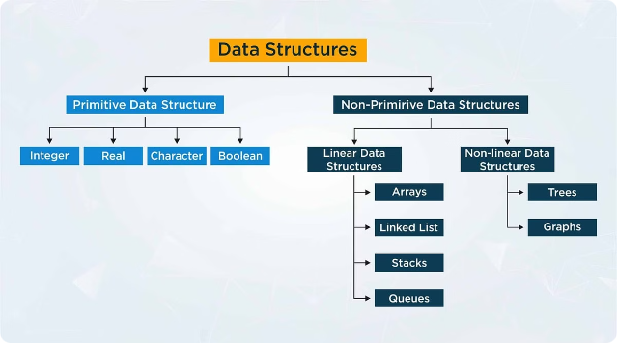
Data Structures Overview
1
Purpose
Efficiently manage and manipulate data in various formats to enhance performance and data access.
2
Key Data Structures
Lists, HashMap, Map, Stack, Linked List.

Slide 9
Lists
ArrayList
LinkedList
Use Cases
Resizable array implementation with fast random access and retrive the data from all users.
linked list with efficient insertions and deletions and use in Payment Section
Manage dynamic lists of products, inventory levels, and customer data.

Slide 10

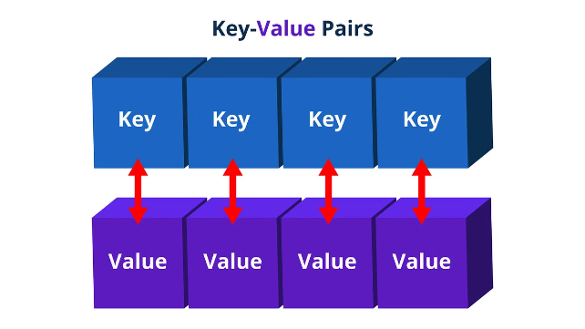
HashMap and Map
HashMap Overview
Stores in User, UserMap that type of operations Used In HashMap.
Map Interface
Provides a contract for key-value mappings, including implementations like HashMap, TreeMap, and LinkedHashMap.
Use Cases
Cache product details, manage pricing information, and store customer preferences.

Slide 11


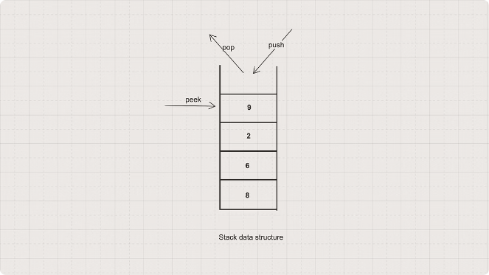


Stack
Push
Add elements to the top of the stack.
Pop
Remove and return the top element.
Peek
View the top element without removing it.

Slide 12
Merits
1
Personalized Service
→ Our pharmacists provide attentive and personalized consultations to ensure your medication needs are met.
2
Convenient Location
→ We're conveniently located for easy access to our services and products.
3
Personalized Attention
→ We strive to provide personalized care and attention to each customer, ensuring they receive the best possible service.

Slide 13
Demerits
Website Functionality Issues
Limited Stock Availability
→ Our website may experience occasional technical glitches, causing interruptions to online services.
→ Occasionally, certain medications may be temporarily out of stock due to supply chain issues or high demand.

Slide 14
Future Scope
Integrating Online Ordering and Delivery
Predictive Analytics for Stock Management
the system only manages the inventory and sales of the pharmacy store. A future scope could be to integrate an online ordering system, where customers can place orders through a website or mobile app, and the system can automatically update the inventory and process the orders for delivery.
The system currently only updates the stock quantity when a sale is made or when new stock is added. A future scope could be to implement predictive analytics to forecast stock requirements based on historical sales data, seasonal trends, and other factors.

Slide 15
Thank You

